Slide 1
HEART DISEASE DIAGNOSTIC ANALYSIS

Slide 2
BUSINESS ANALYSIS
In the wake of the COVID-19 pandemic, the importance of health and medical preparedness has become evident. This project aims to analyze heart disease data to identify key metrics, trends, and factors associated with heart disease. By leveraging ETL processes and exploratory data analysis (EDA), this project seeks to provide actionable insights that can aid in better future preparation and decision-making in the healthcare sector.

Slide 3
Details OF DATA
age: Age of the individual (in years).
sex: Gender of the individual (0 = female, 1 = male).
cp: Chest pain type (0, 1, 2, 3).
trestbps: Resting blood pressure (mm Hg).
chol: Serum cholesterol (mg/dl).
fbs: Fasting blood sugar > 120 mg/dl (1 = true, 0 = false).
restecg: Resting electrocardiographic results (0, 1, 2).
thalach: Maximum heart rate achieved.
exang: Exercise induced angina (1 = yes, 0 = no).
oldpeak: ST depression induced by exercise relative to rest.
slope: The slope of the peak exercise ST segment (0, 1, 2).
ca: Number of major vessels (0-3) colored by fluoroscopy.
thal: Thalassemia (3 = normal; 6 = fixed defect; 7 = reversible defect).
target: Presence of heart disease (1 = yes, 0 = no).

Slide 4
INSIGHTS
Mean: Skewed by high values.
Median: Lower than mean, indicating right skew.
Variance: Shows high data spread.
Skewness: Positive, with a long right tail.
Kurtosis: Leptokurtic, indicating outliers.

Slide 5
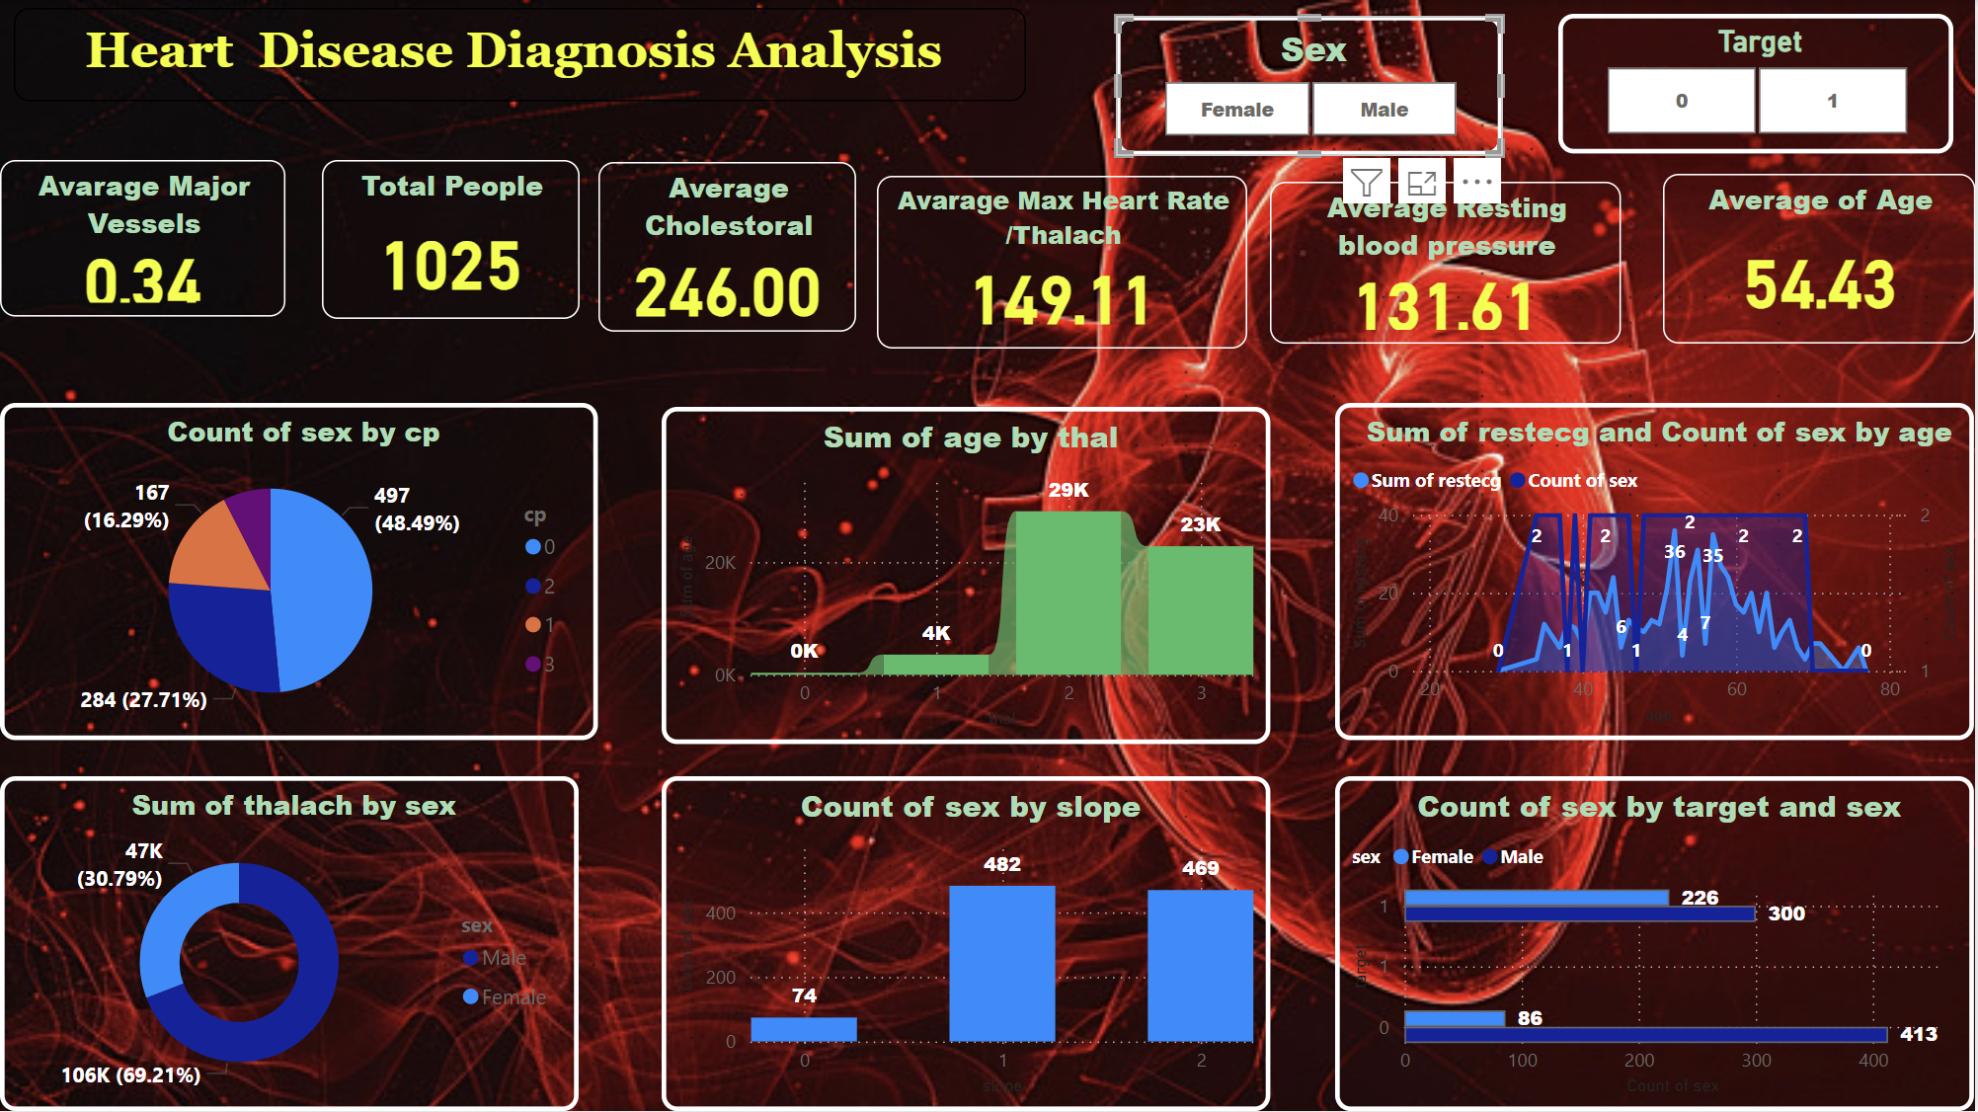
MY DASHBORAD

Slide 6
THANK YOU

